Slide 1

Academic Session 2025-26
ODD Semester Jul-Dec 2025
UNIVERSITY INSTITUTE OF ENGINEERING
COMPUTER SCIENCE ENGINEERING
Bachelor of Engineering
Semester: 6th
Design and Analysis of Algorithms
(23CSH-301/ITH-301)
Unit No. 1 Chapter No. 1 Lecture No.1
Topic : Trees (BST, B Tree
Richa Dhiman E11307 Assistant Professor

Slide 2
1
Learning Objectives & Outcomes
Objective:
To understand the meaning of Tree
To Study its Hierarchical Structure .
To analyze its Parent and Child node structure.
Outcome:
Student will understand
Tree and operations performed on tree
Different Tree Types

Slide 3
2
What is tree??
A tree is a finite nonempty set of elements.
It is an abstract model of a hierarchical structure.
consists of nodes with a parent-child relation.
Applications:
Organization charts
File systems
Programming environments
Computers”R”Us
Sales
Manufacturing
R&D
US
International
Laptops
Desktops
Europe
Asia
Canada

Slide 4
3
Terminologies
Root: node without parent (A)
Siblings: nodes share the same parent
Internal node: node with at least one child (A, B, C, F)
External node (leaf ): node without children (E, I, J, K, G, H, D)
Ancestors of a node: parent, grandparent, grand-grandparent, etc.
Descendant of a node: child, grandchild, grand-grandchild, etc.

Slide 5
4
Terminologies (Contd…)
Depth of a node: number of ancestors.
Height of a tree: maximum depth of any node.
Degree of a node: the number of its children.
Degree of a tree: the maximum number of its node.

Slide 6
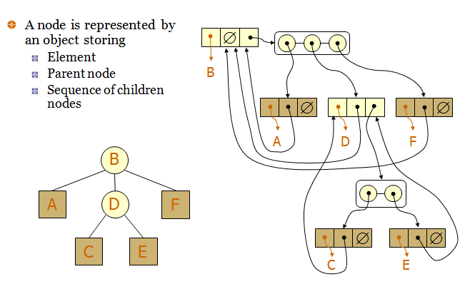
5
Tree representation

Slide 7
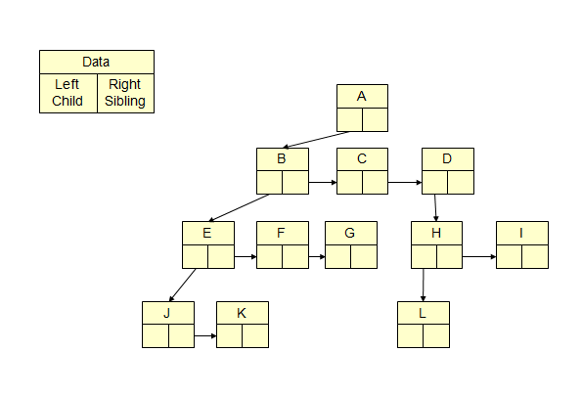
6
Left child, right child and siblings

Slide 8
7
Tree traversal
Two main methods:
Preorder
Postorder
Recursive definition
Preorder:
visit the root
traverse in preorder the children (subtrees)
Postorder
traverse in postorder the children (subtrees)
visit the root

Slide 9
8
Binary tree
A binary tree is a tree with the following properties:
Each internal node has at most two children (degree of two)
The children of a node are an ordered pair
We call the children of an internal node left child and right child
Alternative recursive definition: a binary tree is either
a tree consisting of a single node, OR
a tree whose root has an ordered pair of children, each of which is a binary tree

Slide 10
9
Examples of binary tree
Skewed Binary Tree
Complete Binary Tree
A
A
A
B
B
B
C
C
D
E
F
G
D
E
H
I

Slide 11
10
Full binary tree
A full binary tree of a given height k has 2^{k+1}–1 nodes.
Height 3 full binary tree.

Slide 12
11
Full binary tree (Contd..)
Label the nodes 1 through 2^{k+1} – 1.
Label by levels from top to bottom.
Within a level, label from left to right.
Parent of node i is node i / 2, unless i = 1.
Node 1 is the root and has no parent.

Slide 13
12
Complete binary tree
A labeled binary tree containing the labels 1 to n with root 1, branches leading to nodes labeled 2 and 3, branches from these leading to 4, 5 and 6, 7, respectively, and so on.
A binary tree with n nodes and level k is complete off its nodes correspond to the nodes numbered from 1 to n in the full binary tree of level k.

Slide 14
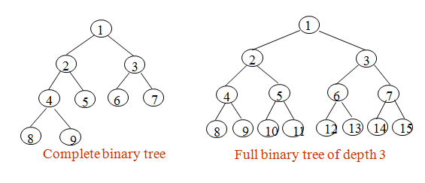
Binary Tree
13

Slide 15
Binary tree traversal
14
Let l, R, and r stand for moving left, visiting the node, and moving right.
There are six possible combinations of traversal lRr, lrR, Rlr, Rrl, rRl, rlR.
Adopt convention that we traverse left before right, only 3 traversals remain
lRr, lrR, Rlr
inorder, postorder, preorder

Slide 16
B Tree
17
All leaves are at the same level.
A B-Tree is defined by the term minimum degree ‘t’. The value of t depends upon disk block size.
Every node except root must contain at least t-1 keys. The root may contain minimum 1 key.
All nodes (including root) may contain at most 2t – 1 keys.
Number of children of a node is equal to the number of keys in it plus 1.
All keys of a node are sorted in increasing order. The child between two keys k1 and k2 contains all keys in the range from k1 and k2.
B-Tree grows and shrinks from the root which is unlike Binary Search Tree. Binary Search Trees grow downward and also shrink from downward.

Slide 17
Applications
20
Hierarchical Data Representation
File systems
Organizational charts
XML/HTML DOM tree structures
Binary Search Trees (BST)
Fast lookup, addition, and deletion of data
Used in databases and memory-efficient searching

Slide 18
Summary
20
Introduction to Trees
Basic terms
Types of Trees
Binary tree
B tree
Balanced trees

Slide 19
21
Next Lecture
AVL Trees

Slide 20
22
Quiz
Which traversal method visits nodes in the order: Left, Root, Right? A) Preorder B) Inorder C) Postorder D) Level Order
In a complete binary tree, which of the following is always true? A) All levels are completely filled B) Leaf nodes are only at the last level C) All levels except the last are completely filled, and nodes are as far left as possible D) Nodes have at most one child

Slide 21
23
References/ Articles/ Videos
Text books:
Cormen, Leiserson, Rivest, Stein, “Introduction to Algorithms”, Prentice Hall of India, 3rd edition 2012. problem, Graph coloring.
Horowitz, Sahni and Rajasekaran, “Fundamentals of ComputerAlgorithms”, University Press (India), 2nd edition
Websites:
https://www.tutorialride.com/data-structures/trees-in-data-structure.htm
https://www.geeksforgeeks.org/avl-tree-set-1-insertion/

Slide 22
24
Faculty-curated videos, NPTEL, Coursera, LinkedIn, or other relevant learning resources
https://onlinecourses.nptel.ac.in/noc23_cs96/preview
https://nptel.ac.in/courses/106106131
https://nptel.ac.in/courses/106106208
https://www.linkedin.com/learning/learning-algorithms

Slide 23
25
Class-Wise Feedback

Slide 24
26
Thank You
For queries
Email: richa.e11307@cumail.in

